Slide 1
Relationship Analysis Process of Web Application
Understanding Entities, Dependencies, and Interactions

Slide 2
Introduction
Relationship analysis in web applications involves identifying and evaluating the interactions, dependencies, and connections between different components, such as users, databases, APIs, and services.

Slide 3
Key Objectives
Understand system components
Identify dependencies
Analyze data flow
Improve performance and scalability
Enhance security and maintainability

Slide 4
Steps in Relationship Analysis
Identify entities (users, databases, services)
Map interactions and dependencies
Evaluate data flow
Detect bottlenecks or risks
Document and optimize relationships

Slide 5
Tools and Techniques
Entity-Relationship Diagrams (ERD)
Data Flow Diagrams (DFD)
Dependency Mapping Tools
Performance Monitoring Tools

Slide 6
Entity-Relationship (E-R) Diagram
Definition: A graphical representation of entities (objects, people, or concepts) and the relationships between them.
Purpose in Web Applications:
Models the database structure before implementation.
Helps developers understand how data is organized and connected.
Ensures consistency and reduces redundancy.

Slide 7
Entity-Relationship (E-R) Diagram
Key Components:
Entities: Represent tables (e.g., User, Order, Product).
Attributes: Properties of entities (e.g., UserID, Name, Email).
Relationships: Connections between entities (e.g., A User places an Order).
Benefit: Simplifies database design, improves data integrity, and helps in system documentation

Slide 8
Data Flow Diagram (DFD)
Definition: A visual representation that shows how data moves through a system, including inputs, processes, storage, and outputs.
Purpose in Web Applications:
Maps how user requests travel through the application.
Identifies processes (e.g., authentication, order processing).
Shows how data is stored and retrieved from databases.

Slide 9
Data Flow Diagram (DFD)
Key Components:
External Entities: Users or external systems providing/receiving data.
Processes: Actions performed on data (e.g., “Validate Login”).
Data Stores: Where data resides (e.g., Database, Cache).
Data Flows: Arrows showing movement of data between components.
Benefit: Helps in understanding system workflow, detecting bottlenecks, and improving design clarity.

Slide 10
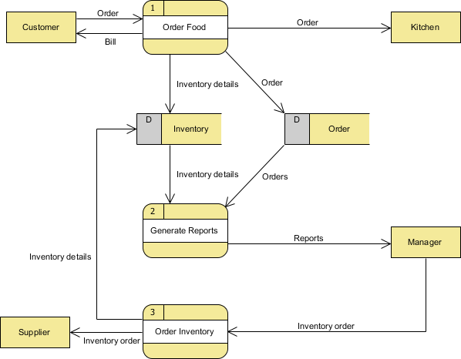
Data Flow Diagram (DFD)

Slide 11
Dependency Mapping Tools
Definition: Tools that visualize and analyze the interconnections between different components, services, and modules in a web application.
Purpose in Web Applications:
Identify service dependencies (e.g., microservices, APIs).
Detect circular or redundant dependencies.
Provide insights into system complexity.

Slide 12
Dependency Mapping Tools
Examples of Tools:
Graphviz: Open-source graph visualization software.
Structurizr: Visual modeling tool for software architecture.
AWS X-Ray / Jaeger: For tracing service dependencies in distributed systems.
Benefits:
Improves architecture visibility.
Helps in troubleshooting failures.
Supports scalability planning and risk analysis.

Slide 13
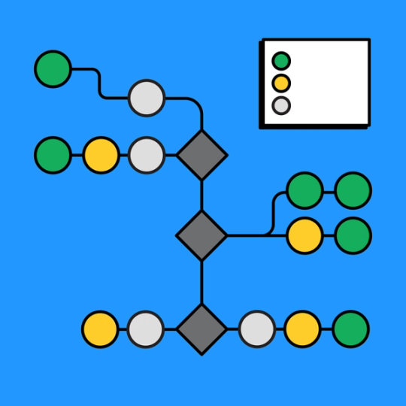
Dependency Mapping Tools

Slide 14
Performance Monitoring Tools
Definition: Tools that track, analyze, and report on the speed, responsiveness, and stability of web applications.
Purpose in Web Applications:
Monitor server performance (CPU, memory, response time).
Detect application bottlenecks.
Track end-user experience (page load time, errors).

Slide 15
Performance Monitoring Tools
Examples of Tools:
New Relic, AppDynamics, Datadog → Real-time application monitoring.
Google Lighthouse → Frontend performance testing.
Nagios, Prometheus + Grafana → Server and infrastructure monitoring.
Benefits:
Ensures smooth user experience.
Helps with early issue detection and prevention.
Provides insights for scaling applications efficiently.

Slide 16
Benefits of Relationship Analysis
Improved system understanding
Enhanced performance
Better scalability
Increased security
Easier maintenance and troubleshooting

